Slide 1



The
Budget
Process
LGIC Budget Workshop
Presented by:
Local Government Services Bureau and MACo

Slide 2

What is a budget and why is it needed?
An Annual Budget is mandated and prepared pursuant to Title 7, Chapter 6, Part 40 MCA.
A budget is the approved plan to finance the governments objectives and goals within a specific time period, one year.
The budget is prepared and presented by fund to the governing body for adoption by resolution.

Slide 3
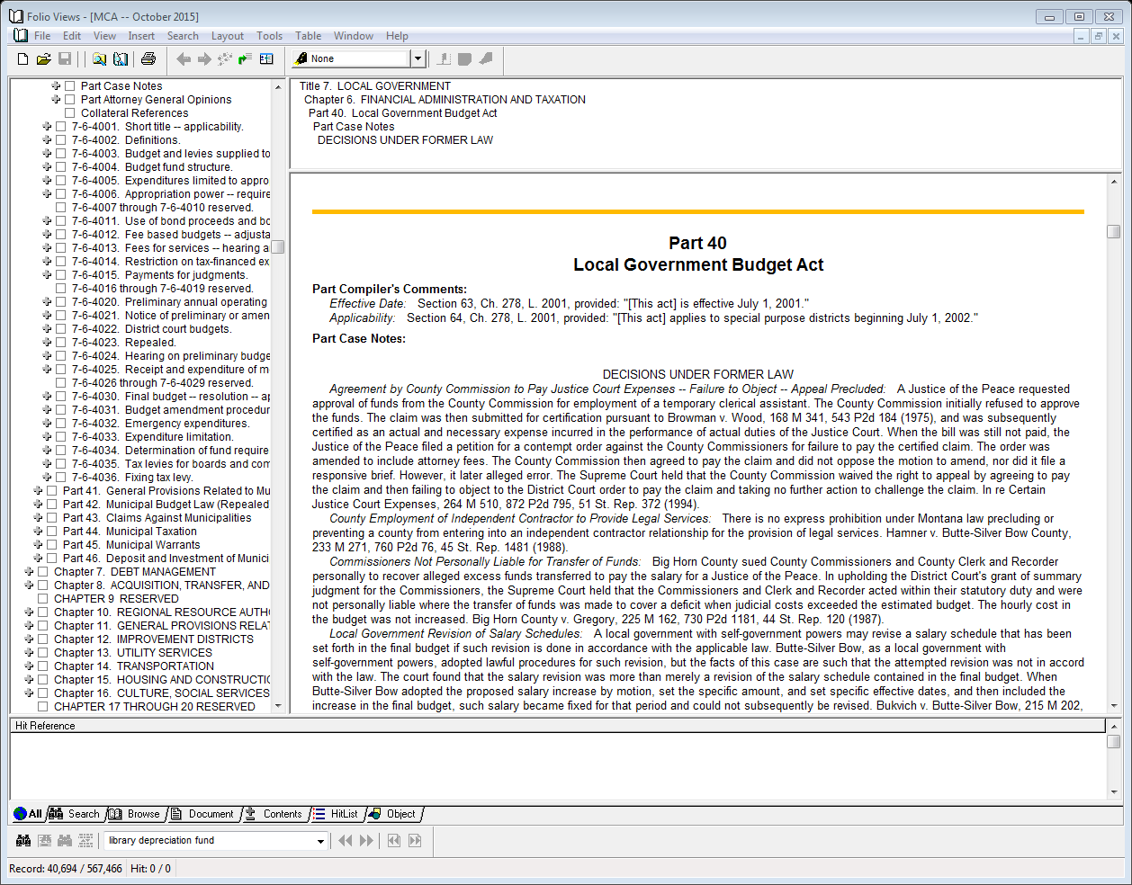
Montana Code Annotated:
Title 7. Local Government
Chapter 6. Financial Administration & Taxation
Part 40. Local Government Budget Act

Slide 4

The Role of the Budget:
  To Set Public Policy
      Allow time for public comment
  Serve as a financial planning tool to implement plans
      Short-term goals and priorities
      Long-term goals and priorities
      Capital asset repair & replacement plan
  Act as a control on taxes and spending

Slide 5
Budgets can be:
Economic: The allocation of scarce resources
Political:
Different interests & goals
Technical: Forecasting the levels of revenues and expenditures

Slide 6
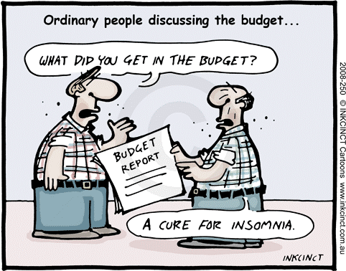
The Budget:
Is an official permanent (legal) document of the local government
Should be printed, signed and kept in a safe and secure location
Document is directly related to, part of and referred to in the resolution approving it
Will be available on the State of Montana Transparency in Local Government Website for public viewing

Slide 7

Who is responsible for County budget preparation?
County Clerk & Recorder:
7-6-4020(3), MCA: Before June 1st, County Clerk & Recorder notifies the County Commission and each board, office, regional resource authority, or official that they are required to file preliminary budget proposals for their component of the total county budget
Component budgets must be submitted to the clerk and recorder before June 10th or on a date designated by the County Commission 7-6-4020(3)(a) MCA
  Submitted on forms provided by the Clerk and Recorder.
  County commission shall submit road and bridge component budgets, construction or improvements to be made from new general obligation debt
  County treasurer shall submit debt service component budgets
The Clerk and Recorder shall prepare and submit the county's preliminary annual operating budget to the County Commission 7-6-4020(3)(c)

Slide 8
Who is responsible for City/Town budget preparation?
7-3-113, MCA Statutory basis for municipal council-mayor government.
7-3-201. Commission-executive form
(council –executive, the council mayor, or the commission-mayor form)
Council members and Mayor(executive) - elected positions
Mayor responsibilities:
7-3-203(10) executes the budget adopted by the commission
7-3-215. Preparation of budget. The executive may:
(1) prepare the budget and present it to the commission for
adoption; or
(2) prepare the budget in consultation with the commission
and department heads.
7-3-114, MCA Statutory basis for municipal commission-manager government.
7-3-301. Commission-manager form (council-manager form)
    Council members – elected position
    Manager (chief administrative officer) – appointed by council
Manager responsibilities:
7-3-304(12) prepare and present the budget to the commission for its approval
and execute the budget adopted by the commission;

Slide 9
Steps of the budgetary process:
Adoption: Final approval by the Governing Body
Hearings: Include departments, sections and the public to discuss changes in the budget
Formulation: Reflecting on the past, set goals for the future and reconcile the difference by reviewing prior year information & estimating future info
Execution: Following the budget to actual comparisons through the year; amending the budget if necessary

Slide 10
Formulation: When can I start on the budget?
Plan throughout the year for the next year’s budget by:
  Keeping notes on plans and priorities discussed during meetings and prioritize projects throughout the year
  Note any upcoming changes to revenues & expenditures
  Review budget to actual comparisons throughout the year as part of internal controls and document significant changes
    Are revenues coming in as planned?
    Have you experienced unanticipated expenditures? Necessary budget amendments?
    Keep accurate accounting records - correct coding errors to funds, account numbers and object codes
Notes:
May depend on how big of a government you are. With many departments might need to start sooner (maybe Jan-Feb?) in a smaller town (maybe March-April). My opinion a good target is to have preliminary budget done end of July with public hearing mid/late-August. Must set tax levy by the later of the first Thursday after the first Tuesday in September or within 30 calendar days after receiving certified taxable values

Slide 11

Types of Budgets by Fund
NON FEE-BASED OR FIXED BUDGETS
Fixed Appropriations
Funds whose appropriations are not fee based
Spending cap cannot be exceeded without first passing a budget amendment
FEE-BASED OR FLEXIBLE BUDGETS
7-6-4012, MCA
Adjustable Appropriations
Enterprise funds and
funds whose appropriations
are identified in budget
resolution as fee-based
appropriations
In its final budget resolution, the governing body may authorize adjustments to appropriations
funded by fees throughout the budget period

Slide 12

Should the local government wait until after they calculate the mill levy to start the budget?
No
  For levied funds
    Estimate your mill levy by using the amount that was levied in the prior fiscal year to start your budget for the levied funds.
  For non-levied funds
    Review revenue sources; Use the amount of your charges for services in the prior fiscal year plus any approved rate increases

Slide 13
Considerations during the formulation process:
Prior year revenues & expenditures: Will they be similar in upcoming year?
Capital projects and capital grants: Continuing or new projects
    (Remember to budget expenditures for grants and loans)
Repairs necessary to equipment, infrastructure & facilities
Changes in the cost to provides services: Utility rate increases, gas price fluctuations, chemicals and supplies, etc.
Changes in charges for services and assessments charged:
  Rate times # of customers = charges for services
Changes in Intergovernmental Revenues – gas tax, state entitlement, PILT
Payroll changes: Raises, personnel changes, cost of benefits, upcoming retirements (vacation, sick leave payouts)
Other Fixed Charges: Liability and comp insurance, maintenance agreements
Due to/from others and transfers
Loan Proceeds and Debt Service Payments
Year-end Accruals (Expenses and Revenues): Make appropriate entries to cover them and to help insure a 12 month budget cycle

Slide 14

Preliminary Budgets
7-6-4020 Preliminary annual operating budget for each fund includes among other items;
Listing of all revenue, including tax revenue, and other resources by source for the prior budget year, current budget year, and proposed budget year.
Listing of all expenditures by function & classification for the prior budget year, the current budget year, and the proposed budget year.
A projection of changes in fund balances or cash balances available for governmental funds and a projection of changes in cash balances and working capital for proprietary funds.
7-6-4021(1) The governing body shall cause a notice of a public hearing on the preliminary or amended budget to be published.
(b) state that the budget or budget amendment has been placed on file and is open to inspection in the county office designated in the notice;
7-1-2121 Publication and content of notice -- proof of publication. (2) Publication must be in a newspaper, unless the County does not have a newspaper. Should be published twice, 6 days separating each publication

Slide 15
Terms used in the budget:
Appropriations
Amount budgeted to spend (expenditures or expenses)
Working Capital
Property Tax Revenues
The amount collected from ad valorem (property) taxes based on the mill levies. Does not include penalty and interest on delinquent taxes and local option taxes.
Non-tax revenues
All revenues including grants, state entitlements, charges for services, local option tax, penalty & interest on taxes and donations. Does not include the amount that will be collected from the mill levies for real, personal and mobile home property taxes.
A fund’s current assets minus current liabilities and designated reserves MCA 7-6-4002
Cash available
Cash on hand July 1st less any liabilities for claims/accounts payable from prior fiscal year

Slide 16
Terms used in the Budget cont.
Total Requirements
Total Resources
Appropriations + Cash Reserves
Cash Available + Total Revenues
Total Revenues = Non-Tax + Property Tax Revenues
Appropriations & Cash Reserves = Available Cash & Revenues
Budgeted Cash Reserves can not be negative
Balanced Budget
Total Resources
Total Requirements

Slide 17
7-6-4006(4) The governing body may amend the budget during the fiscal year by conducting public hearings at regularly scheduled meetings.
Budget amendments providing for additional appropriations must identify the fund reserves, unanticipated revenue, or previously unbudgeted revenue that will fund the appropriations.
7-6-4001 (2) This part applies to all local governments.
Montana Code Annotated
Local Government Budget Act
Title 7
Chapter 6
Part 40
7-6-4004 Local government budgets must conform to the fund structure prescribed by the Department of Administration.
7-6-4005 (1) Local government officials may not make a disbursement or an expenditure or incur an obligation in excess of the total appropriations for a fund.
(2) A local government official who violates subsection (1) is liable for the amount of the excess disbursement, expenditure, or obligation personally.
7-6-4014 Restriction on tax-financed expenditures if voter approval required.
Voted mill levies pursuant to 15-10-425, MCA.
7-6-4025 A local government may receive and expend money between July 1 of the fiscal year and the date the final budget resolution is adopted.

Slide 18
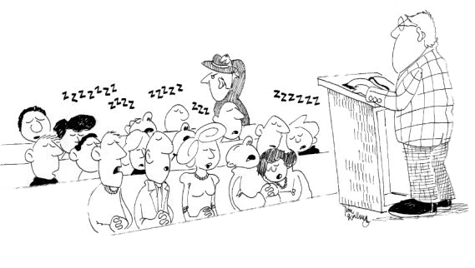
Hearing on Preliminary Budget
  7-6-4024. Hearing on preliminary budget.
  (1) The governing body shall hold a hearing in accordance with the notice given pursuant to 7-6-4021.
  (2) Local government officials shall attend the budget hearing to answer questions on their proposed budgets if called upon:
  (a) by the governing body; or
  (b) by a taxpayer or resident.
  (3) The hearing may be continued from day to day and must be concluded and the budget finally approved and adopted by resolution by the later of the first Thursday after the first Tuesday in September or within 30 calendar days of receiving certified taxable values from the Department of Revenue.
The Commissioners could usually tell when they started to lose their constituents

Slide 19
Budget Timeline - Statutory Due Dates
15-10-202(1). Certification of taxable values. by the first Monday in August, the department of revenue shall certify to each taxing authority the total taxable value within the jurisdiction of the taxing authority.
Three
15-10-305(1)(a) The county clerk and recorder shall by the second Monday in September or within 30 calendar days after receiving certified taxable values notify the department of the number of mills needed to be levied for each taxing jurisdiction in the county.
Four
Two
One
Preliminary budget phase up to the later of the first Thursday after the
Five
7-6-4003 (1) Submit copy of the final budget together with a statement of tax levies to the department of administration by the later of October 1 or 60 days after receipt of taxable values…
7-6-4024(3) Final budget resolution
7-6-4036 Fixing tax levy
by the later of the first Thursday after the first Tuesday in September or within 30 calendar days of receiving certified taxable values.
first Tuesday in September or within 30 calendar days of receiving
certified taxable values.

Slide 20


Mill
Levies

Slide 21


What is a mill?
Mills are the units used to calculate ad valorem property taxes
The mills are multiplied by the certified taxable valuation to generate tax revenue
The term “mill” comes from a Latin word meaning “thousandth”
“Ad Valorem” means based on value

Slide 22

TYPES OF MILL LEVIES
Non-Voted
15-10-420, MCA
Mills authorized to be levied without a vote
Unrestricted
Determined annually by completing the Determination of Tax Revenues and Mill Levy Limitation form
Funding source for statutes that say “Subject to 15-10-420…”
Voted
15-10-425, MCA
Must adopt resolution to place question on ballot
Restricted by purpose
Resolution must state;
1) specific purpose
2) EITHER – specific
revenue amount and
approximate # of
mills, OR, specific
mills and approximate
revenue amount
3) Permanent (perpetual) or
durational limit
4) Impact on homes
having a value of
$100,000 & $200,000
Not subject to 15-10-420
Permissive
Mills authorized to be levied without a vote
Restricted by purpose
Examples, 15-10-420(9)(a)(i)
through (iv), MCA;
*judgment levy
*levy to repay taxes
paid under protest
*emergency levy
*study commission
levy
*group benefit
levy
Not subject to 15-10-420

Slide 23
Voted Levy Impact Calculation Spreadsheets
Brought to you by MACo
http://www.mtcounties.org/resource
Under Fiscal Forms,
click on ‘Voted Levy Information’
Click on ‘Special Mill Levy Calculation Spreadsheet’

Slide 24
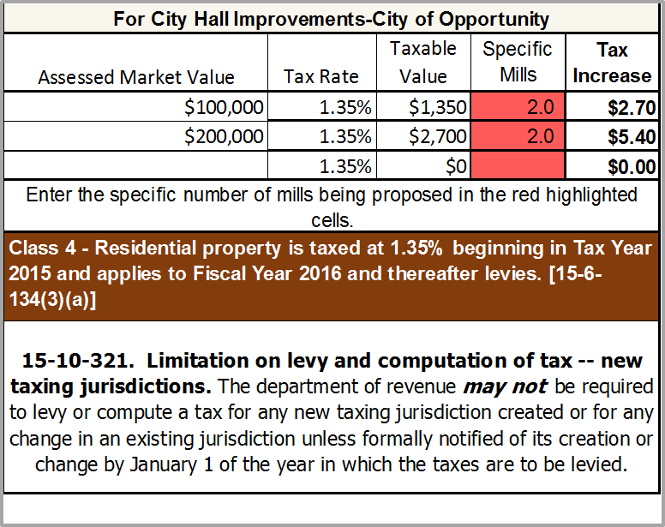
VOTED LEVY – Specific Mills

Slide 25
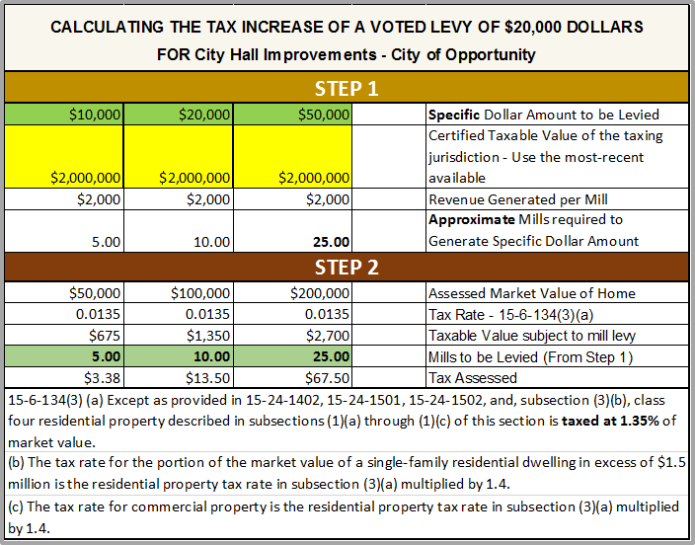
Voted Levy – Specific Dollar Amount

Slide 26

Sample Ballot Language – “Fixed”
Shall the City of Opportunity be authorized to levy two (2) mills, being approximately $4,000, for a period of five (5) years to fund City Hall repairs?
The fiscal impact on a home having a market value of $100,000 is estimated to be $2.70 each year of the levy and on a home having a market value of $200,000 is estimated to be $5.40 each year of the levy.

Slide 27
Sample Ballot Language – “Float”
Shall the City of Opportunity be authorized to levy two (2) mills, being approximately $4,000, for a period of five (5) years to fund City Hall repairs, where the new levy will be subject to 15-10-420(1)(a), MCA after the first year allowing for inflationary growth and newly taxable growth?
The fiscal impact on a home having a market value of $100,000 is estimated to be $2.70 for the first year of the levy and on a home having a market value of $200,000 is estimated to be $5.40 the first year of the levy.

Slide 28
The
Determination of
Tax Revenue and
Mill Levy Limitation Form

Slide 29
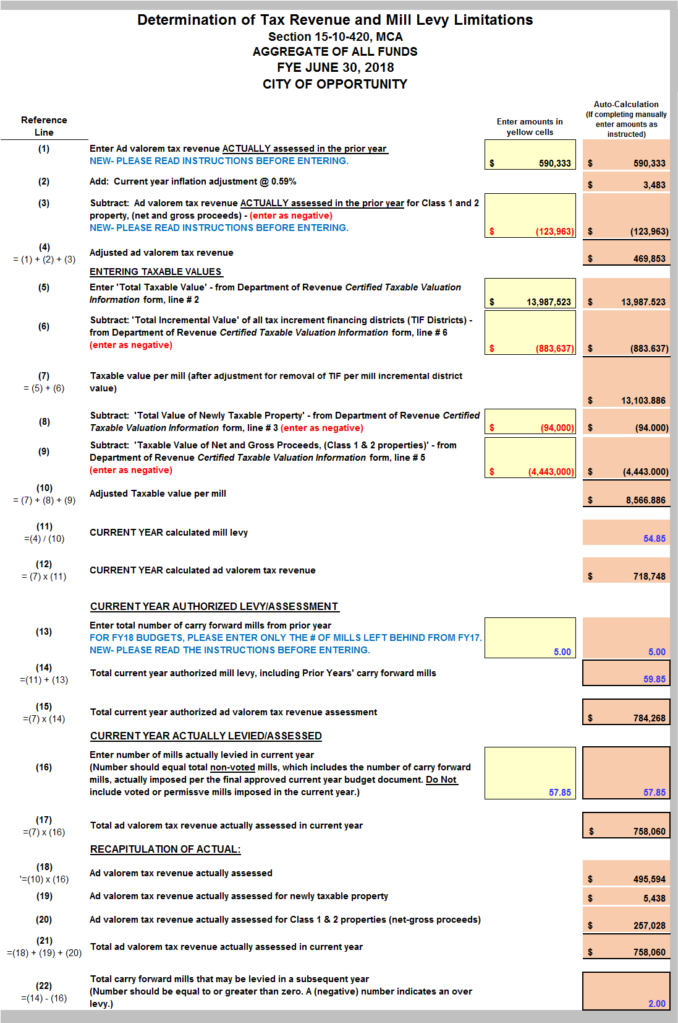

Slide 30
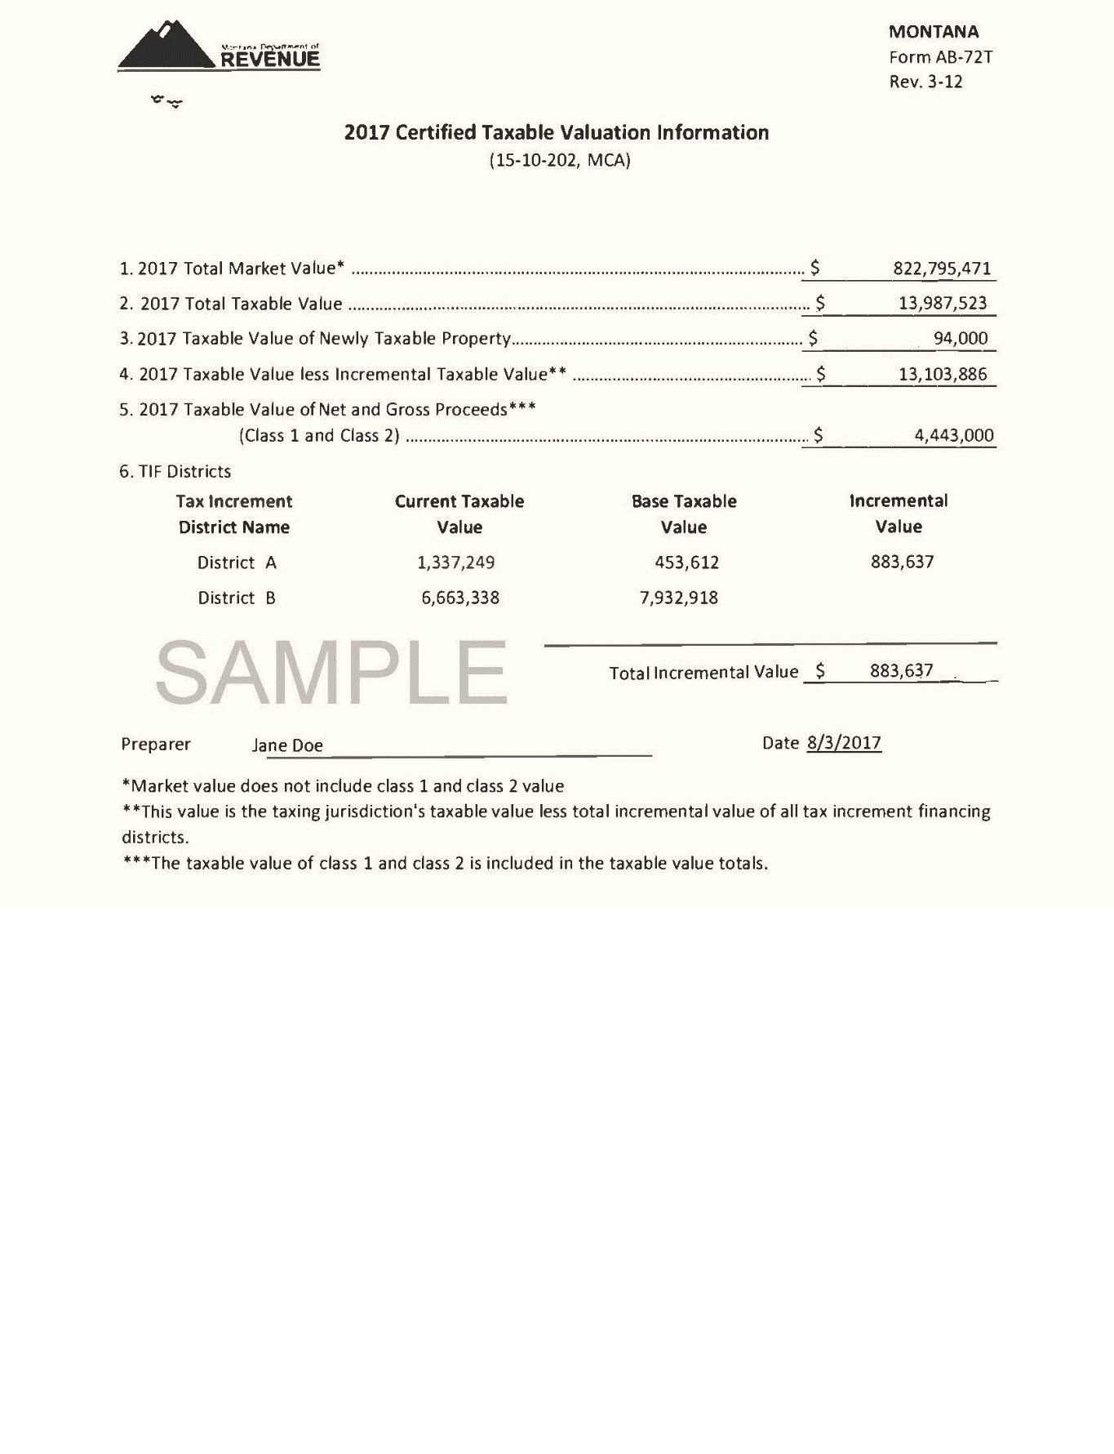
DOR-Certified Taxable Valuation Information
(usually received first week in August)
Use 2017 Certified Taxable Valuations
to complete
FY2018 Levy Comp form.
  NOTE…The taxable value per mill = 20XX Taxable Value less (TIF’s) Incremental Taxable Value / 1000

Slide 31
Permissive Levy for
Group Benefits

Slide 32
Permissive Levy for Group Benefits
Is an additional levy and separate from the “aggregate” mill levy calculated on the Mill Levy Determination Form according to 15-10-420 MCA
  Covers the increase in contributions for medical & life group benefits and payments in lieu of group benefits
    Does not cover property, liability & casualty insurance
  For employees & officers not paid wholly or in part by user charges in proprietary funds. (Only the portion of benefits paid from a governmental fund can be used)
  Is re-calculated every year after a base year has been established using the Permissive Levy Form on DOA LGSB website
  Must be deposited into Fund 2372 – Permissive Levy
Notes:
ONLY DO THESE SLIDES IF THE CLASS (ANYONE IN THE CLASS) WANTS TO> IF no then just move on and skip slides

Slide 33
Steps in the Permissive Medical Levy Process:
Determine a base year per 2-18-703(4)(c) MCA:
If the entity made contributions for group benefits beginning in July of FY2000 and levied the Permissive Levy in FY2002 or any year after – the Base Year is FY2000
If the entity did not make contributions for group benefits in or prior to FY2000 and subsequently did so, and has levied Permissive Mills the first year the entity provided contributions for group benefits beginning in July is the Base Year
If the entity has made contributions for group benefits beginning in July of a fiscal year but has not Permissively Levied the entity must first establish their base year – the Base Year will be the FY immediately proceeding the year the Permissive Levy will first be levied.
Note: to establish a Base Year the entity must have begun employer contributions in July of the Fiscal Year.
Once established – the Base Year is permanent.

Slide 34


Permissive Medical Levy
A Public Hearing must be held –
  The hearing can be held on the same day and time as the budget hearing as long as notice is given
The levy should be approved by the governing body after a public hearing
Listed separately on the tax bills

Slide 35
The
Budget Document

Slide 36
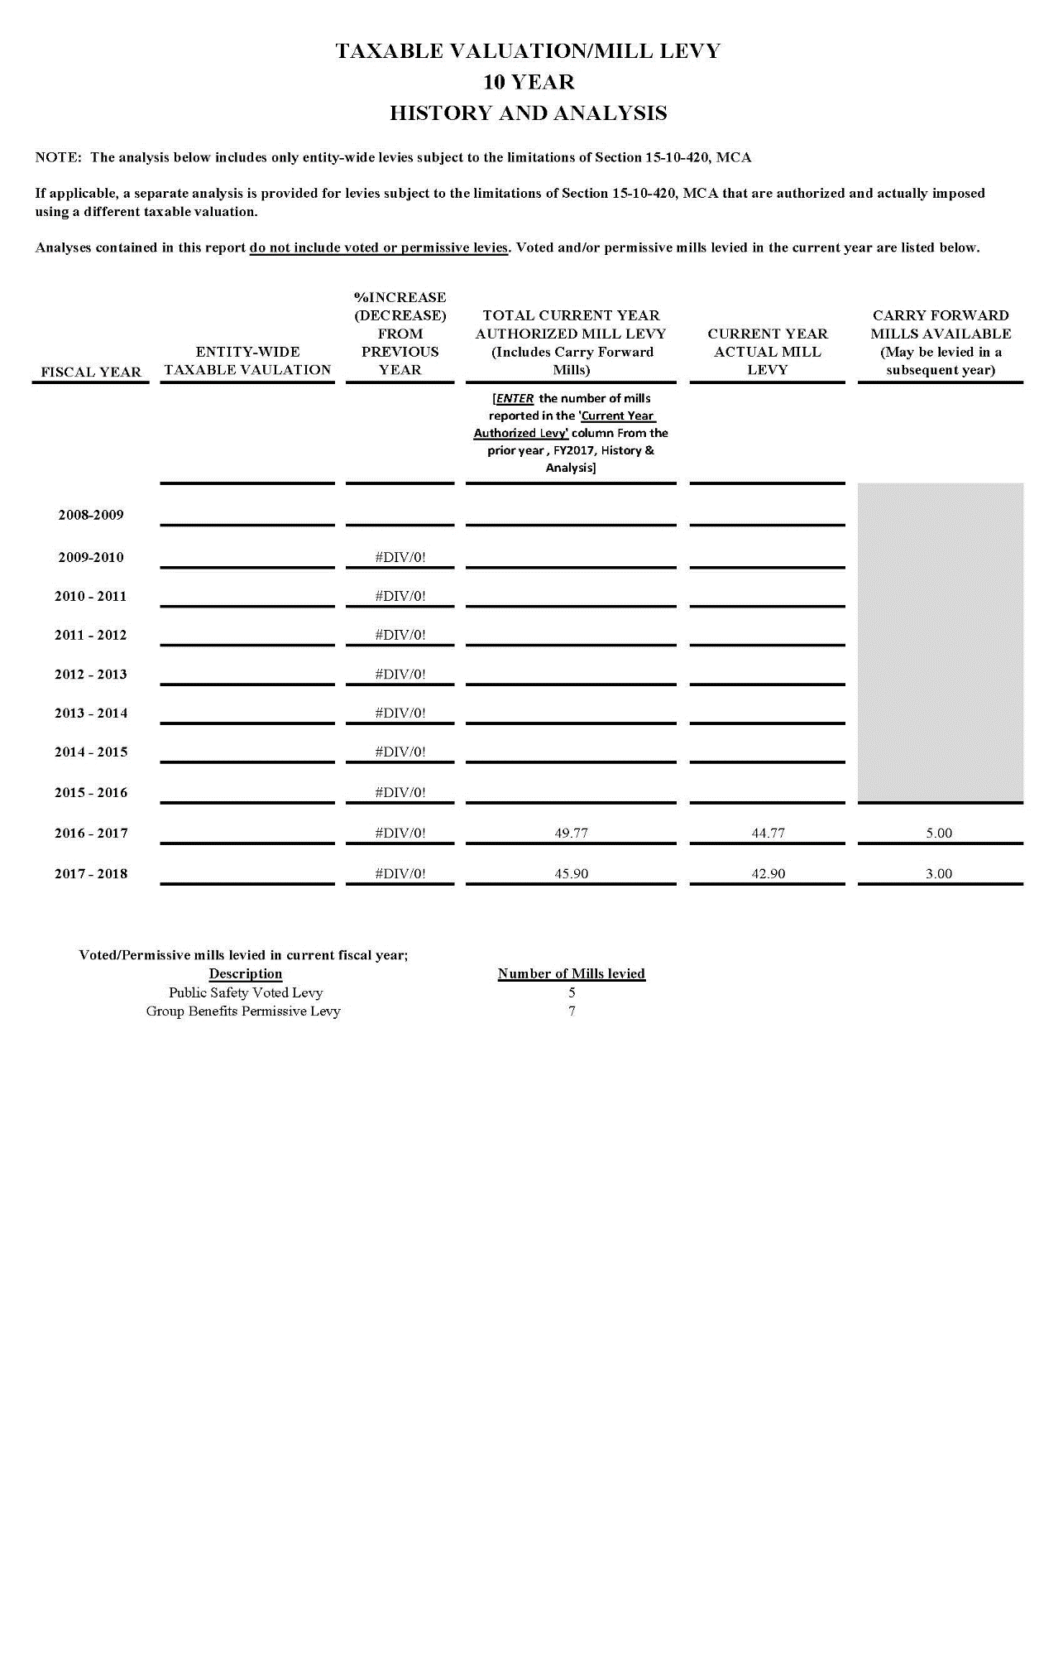
PAGE 9 OF THE BUDGET DOCUMENT
Only Last
10 YEARS
For 2008-2009 through 2016-2017…Enter number of mills reported on the prior year, FY2017, budget report…History & Analysis (page 9), in the Current Year Authorized Levy column.
Enter actual number of mills levied in the current year.
Auto-calculation of carry forward mills available
Enter description and number of voted/permissive mills levied in current year.

Slide 37


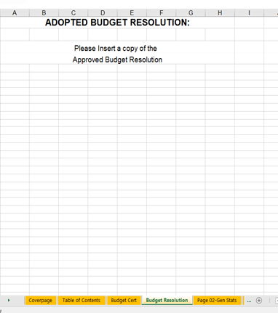
Budget Resolution
Resolution
Insert a copy of the Approved Budget Resolution

Slide 38
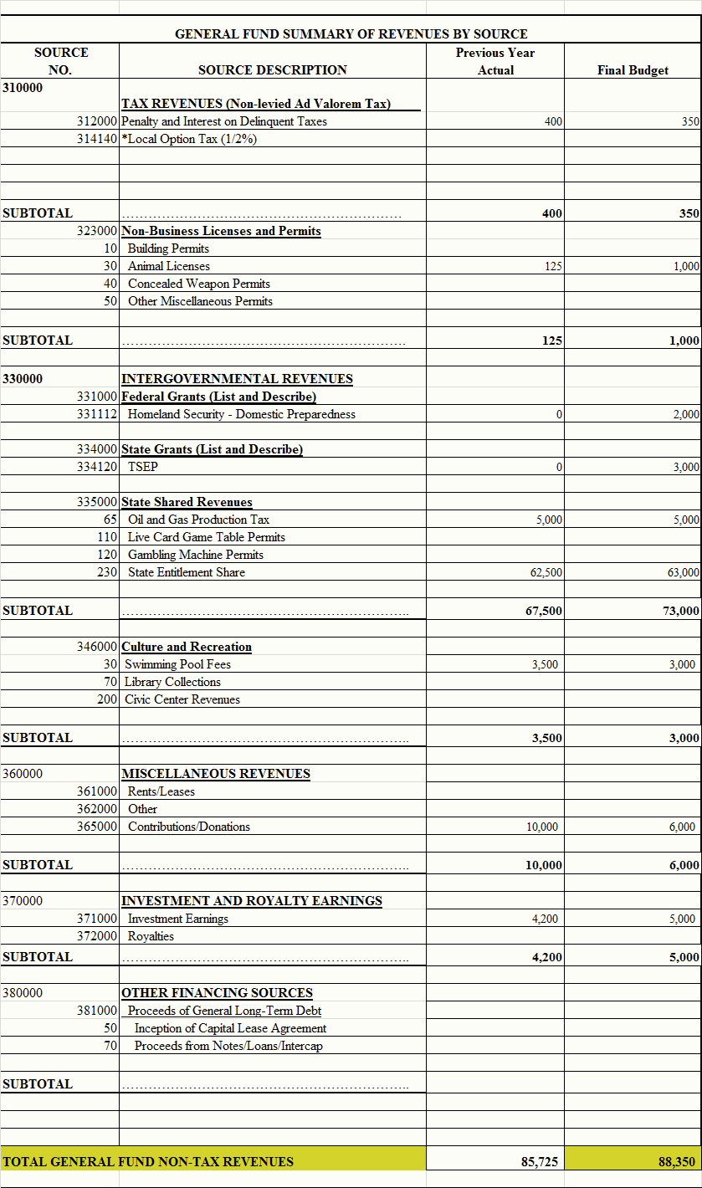
Budget
‘Non-Tax Revenue’ detailed by source
for each fund
Examples:
Tax Revenues includes: Local Option, Penalty & Interest
Licenses & Permits
Intergovernmental Revenues
Charges for Services
Investment Earnings
Other Fin. Sources
LICENSES AND PERMITS
CHARGES FOR SERVICES

Slide 39


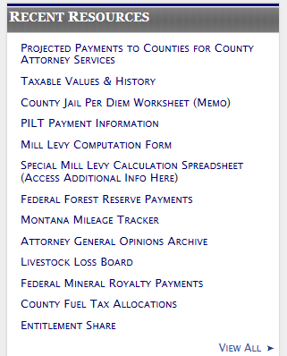

Sources to accurately budget State-Shared Revenues
http://www.mtleague.org/
http://revenue.mt.gov/home/local_governments#horizontalTab3
Notes:
http://revenue.mt.gov/home/local_governments

Slide 40
Appropriations-Level of Budgetary Control:
Fund: General: 1000
Function: General Govt.: 41xxxx
Activity: Financial Services: 410500
Sub-activity: Administration: 410510
Object: Personal Services: 410510 - 100
Sub-object Level: Salaries/Wages: 410510 - 110
This detail may provide better management and planning.
State documents only require summary level information.
Example: by object codes - 100, 200-800, 600-699, and 900
NOTE: Legal budgetary control is at total fund level, MCA 7-6-4005

Slide 41
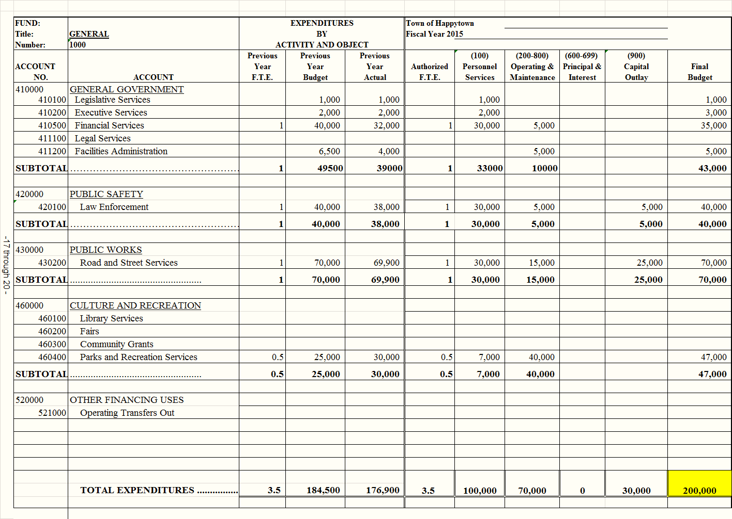
Clerk based on prior year’s final budget after budget amendments and actual amounts from accounting system
Department Heads and
Commission
Expenditures
are detailed
by Function
and Object codes for each fund:
100’s: Payroll expenses
200-800:
Operating Supplies
600’s:
Principal & Interest
900’s:
Capital Outlay
Governing Body
City of Opportunity
Fiscal Year 2018

Slide 42
Determination of Property Tax Levy by Fund according to MCA
7-6-4034, MCA Determination of fund requirements -- property tax levy
After determining the final budget, the governing body shall determine the property tax levy
needed for each fund by:
(a) adding the total amount of the appropriations and authorized expenditures for the
budget year;
(b) adding an additional amount, subject to the provisions of subsection (2), as a
reserve to meet expenditures made from the fund during the months of July to
November of the next fiscal year;
(c) subtracting the working capital; and
(d) subtracting the total estimated revenue, other than the property tax levy, for the
budget year.
After deducting from the amount of the appropriations and authorized expenditures the total
amount appropriated and authorized to be spent for election expenses and payment of
emergency warrants, the amount that may be added as a reserve, as provided in subsection
(1)(b), to:
(a) a county's fund may not exceed one-third of the total amount appropriated and
authorized to be spent from the fund during the current fiscal year; and

Slide 43

Proper completion of;
Tax Levy Requirement Schedules
Non-Levied Funds Summary Schedule
assures compliance.

Slide 44
1…Tax Levy Requirement Schedule
Non-voted Levies
funds that receive
tax revenue from
non-voted levies

Slide 45
The Tax Levy Requirements Schedule
Non-Voted Levies
From DOR Certified Valuations
45,000,000
2,000,000
2,000
Counties Maximum 33% of Appropriations
Computed as the tax revenue necessary to balance the General Fund budget
Computed as the number of mills necessary to allocate to the General Fund
Total Non-tax revenue from detailed budget page
Total expenditures from detailed budget page
Cities/Towns Maximum 50% of Appropriations
From accounting system
200,000
100,000
300,000
109,990
88,350
101,660
190,010
300,000
50.83
100,000

Slide 46
Review of Schedule - Non-Voted Levies
1…Does the Schedule present a balanced budget for each fund?
45,000,000
2,000,000
2,000
200,000
100,000
300,000
109,990
88,350
101,660
190,010
300,000
50.83
100,000
27,825
5,255
33,080
5,250
250
27,580
27,830
33,080
13.79
5,255
24,926
-0-
24,926
-0-
3,946
20,980
24,926
24,926
10.49
-0-
252,751
105,255
358,006
115,240
92,546
150,220
242,766
358,006
75.11
105,255
Column (3) Column (8)
Total Requirements…… must equal…… Total Resources

Slide 47
Review of Schedule - Non-Voted Levies
2…Is the budgeted cash reserve in compliance for each fund receiving property
tax revenue from non-voted levies?
45,000,000
2,000,000
2,000
200,000
100,000
300,000
109,990
88,350
101,660
190,010
300,000
50.83
100,000
27,825
5,255
33,080
5,250
250
27,580
27,830
33,080
13.79
5,255
24,926
-0-
24,926
-0-
3,946
20,980
24,926
24,926
10.49
-0-
252,751
105,255
358,006
115,240
92,546
150,220
242,766
358,006
75.11
105,255
Column (2)
Cities/Towns - Maximum of 50% of Appropriations
Counties – Maximum of 33% of Appropriations
7-6-4034(2)(b), MCA

Slide 48


Purpose of Budgeted Cash Reserves:
Cash reserves in a fund are used to meet expenditures/expenses made from that fund during the months of July to November
  Provide “cash flow” for levied funds awaiting the next major “tax payment”
  Cash reserves are limited for counties to 1/3 and municipalities to ½ of the total amount appropriated and authorized to be spent from the tax-levied fund during the fiscal year
    7-6-4034(2)(a) Counties; 7-6-4034(2)(b) Cities/Towns
  Cash reserves should not be looked at as a “savings account” or “rainy-day fund” although they can be used in times of emergencies
    A plan to replenish should be made if used for emergencies

Slide 49
Reserves in Levied Funds:
What may be needed in cash reserves?
Take the appropriations for the year
- Divide by 12 to figure the monthly amount of appropriations
(Or review prior year actual expenses from July thru October or November and use that total)
Multiply the monthly amount by 4
Or use actual expenditures from prior year: July through October
This may be the minimum in cash reserves you keep for levied funds to ensure adequate cash flow
  Example:
    Total General Fund appropriations from prior year was $200,000
    $200,000/12 months = $16,667 a month
    $16,667 x 4 = $66,668 or 33%
    Minimum cash reserves to consider in General Fund should maybe be $66,668
      Reserves will provide cash flow from July to November

Slide 50



The Danger of not having cash reserves:
  Negative cash balances in funds
    This is the equivalent of “unofficial & unapproved borrowing” from another fund
  Cash Flow issues
  Trouble if anticipated revenues are not received as predicted in the budget or cost to provide services increases mid-year
  Hardship in times of equipment failure, disasters or other emergencies

Slide 51
Review of Schedule - Non-Voted Levies
3…Is the budgeted cash reserve for the fund too low?
45,000,000
2,000,000
2,000
200,000
40,000
240,000
109,990
88,350
41,660
130,010
240,000
20.83
40,000
27,825
5,255
33,080
5,250
250
27,580
27,830
33,080
13.79
5,255
84,926
84,926
-0-
-0-
3,946
80,980
84,926
84,926
40.49
-0-
312,751
45,255
358,006
115,240
92,546
150,220
242,766
358,006
75.11
45.255
CAUTION: Depending on the purpose of the fund and timing of non-tax revenue & expenditures from the fund…If Cash Reserves are less than 25% of Appropriations, cash flow issues may occur in the fund from July through November of the subsequent fiscal year before the fund receives it’s first tax revenue payment in December.
Column (2)
General Fund cash reserve = 20% of Appropriations

Slide 52
Review of Schedule - Non-Voted Levies
4…Is the budgeted cash reserve for each fund equal to or greater than -0-?
45,000,000
2,000,000
2,000
200,000
100,000
300,000
109,990
88,350
101,660
190,010
300,000
50.83
100,000
27,825
5,255
33,080
5,250
250
27,580
27,830
33,080
13.79
5,255
24,926
-0-
24,926
-0-
3,946
20,980
24,926
24,926
10.49
-0-
252,751
105,255
358,006
115,240
92,546
150,220
242,766
358,006
75.11
105,255
A negative budgeted cash reserve or estimated ending cash balance indicates…
cash flow issues; and
the fund is borrowing from another fund to pay its bills
Column (2)
Column (11)

Slide 53
Review of Schedule - Non-Voted Levies
4…Is budgeted cash reserve for each fund stable?
45,000,000
2,000,000
2,000
200,000
100,000
300,000
109,990
88,350
101,660
190,010
300,000
50.83
100,000
27,825
5,255
33,080
5,250
250
27,580
27,830
33,080
13.79
5,255
24,926
-0-
24,926
-0-
3,946
20,980
24,926
24,926
10.49
-0-
252,751
105,255
358,006
115,240
92,546
150,220
242,766
358,006
75.11
105,255
(9,990)
CAUTION: if this trend continues as opposed to decreasing budgeted appropriations… your cash reserves in the fund will keep decreasing and may cause a cash flow issue in future years.
5

Slide 54
2…Tax Levy Requirement Schedule
Voted/Permissive Levies
Funds that receive
tax revenue from
voted/permissive
Levies

Slide 55
Tax Levy Requirements Schedule
Voted / Permissive Levies
5,806
2,000
7,806
2,526
-0-
5,280
5,280
7,806
2.64
2,000
35,000
12,806
47,806
27.556
250
20,000
20,250
47,806
10.00
12,806
40,806
14,806
55,612
30,082
250
25,280
25,530
55,612
12.64
14,806
NOTE:
Same procedures apply as with Tax Levy Requirements Schedule-Non-Voted Levies
EXCEPT…No limitation on budgeted cash reserve…unless otherwise specified by statute.

Slide 56
3…Non-Levied Funds Summary Schedule
Funds that:
Do not receive
tax revenue
Receive revenues or
inflows from other
sources

Slide 57
Non-Levied Funds – Summary Schedule
10,000
35,500
45,500
25,000
20,500
45,500
35,500
343,956
1,169,964
1,513,920
1,121,420
392,500
1,513,920
1,169,964
658,786
1,591,304
2.250,090
1,523,864
726,226
2,250,090
1,591,304
1,012,742
2,796,768
3,809,510
2,670,284
1,139,226
3,809,510
2,796,768
Column (3) Column (6)
Total Requirements… must equal ...Total Resources

Slide 58
Non-Levied Funds – Summary Schedule
10,000
35,500
45,500
25,000
20,500
45,500
35,500
343,956
1,169,964
1,513,920
1,121,420
392,500
1,513,920
1,169,964
658,786
1,591,304
2.250,090
1,523,864
726,226
2,250,090
1,591,304
1,012,742
2,796,768
3,809,510
2,670,284
1,139,226
3,809,510
2,796,768
Ensure the budgeted cash reserves will cover any 3rd party restrictions – example: future debt payments
No limitation on
on budgeted cash …………….…...BUT......................may be a
reserves limitation on
cash balance

Slide 59


Monitoring the budget throughout the fiscal year:
Monthly…review of YTD budget to actual reports.
* For Revenues
- by fund
- by source
* For Expenditures
- by fund
- by account number
- by object code
Why? If Revenues aren’t coming in is as anticipated you may need to limit the fund’s budgeted appropriations.
You may be faced with making unanticipated appropriations that were not budgeted.
*Determine if a budget amendment is
necessary before an expenditure is incurred.
7-6-4005 (1), MCA
BILLS

Slide 60
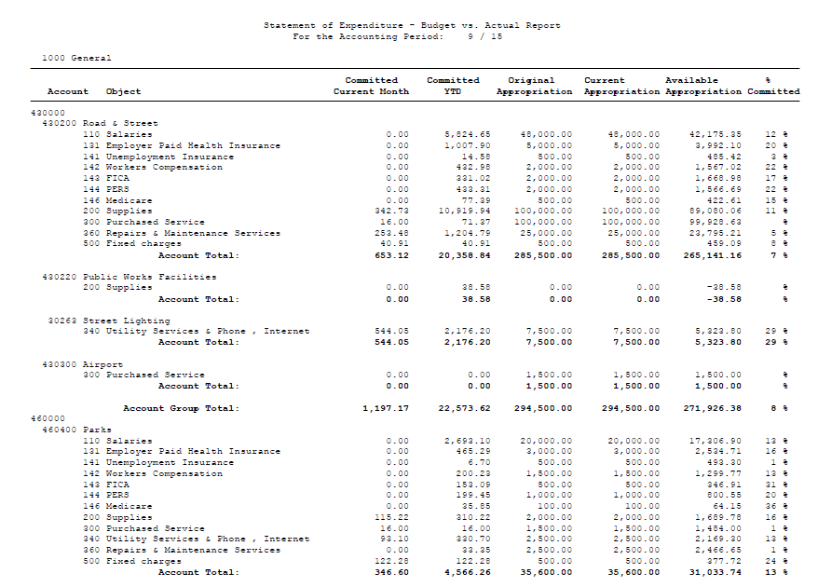
Expenditure – Budget to Actual Report

Slide 61
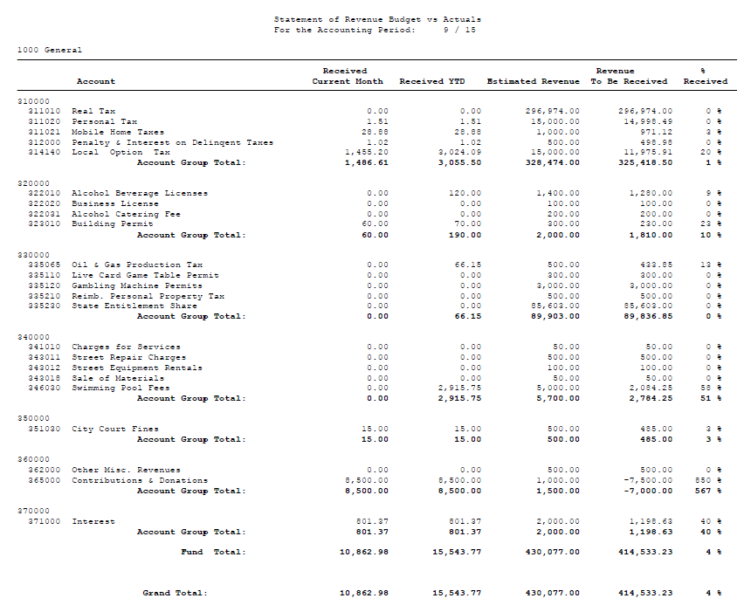
Revenues: Budget to Actual Report

Slide 62
When monitoring the budget -
  An expenditure was coded as object code 900 but does not meet our capital asset threshold amount
    The coding of the expenditure should be changed to correctly classify the purchase (a journal voucher should be prepared to change the object code to properly classify the purchase)
  An account line item within a fund exceeded the budget
    Does the fund report a fixed budget or a fee-based budget?
      A fee based budget has adjustable appropriations:
      If the appropriation was based on the cost of providing services
      And the budget resolution allows for adjustable appropriations
    Did the account line item that exceeded the budget cause the fund’s budget in total to exceed the amount budgeted?
      If the answer is …..
        No – the fund has remaining budget authority in total – No action is required
        Yes - the fund’s budget exceeded the amount budgeted in total for the fund - A budget amendment may be necessary if the budget isn’t a fee-based budget

Slide 63

Budget Amendments:
Follow the procedures for a budget amendment
The governing body may amend the budget during the fiscal year by conducting a public hearing at a regularly scheduled meeting. 7-6-4006(4) MCA
    Publication: 7-6-4021 MCA (County 7-1-2121)
    The notice must be published twice, with at least 6 days separating each publication.
  Budget amendments providing for additional appropriations must identify the fund cash reserves, unanticipated revenue or previously unbudgeted revenues that will fund the appropriations.
If the amendment is an emergency:
  The emergency budget appropriations must be adopted by 2/3 of the governing body who are present at the meeting. 7-6-4032 MCA

Slide 64
Recap of the Budget process:
Complete the prior year actual numbers
Compile information for upcoming budget:
Figure any additions, deletions, increases, etc. or trending
Consider fixed costs – payroll, materials, utilities
Review any capital asset additions, repairs, etc.
Include current year loan payments for principal & interest
Upcoming grant applications/awards
Determine cash reserves
Important in levied funds for cash flow for first four months
Can’t have negative cash reserve!
Ensure budgets are in balance
Total Requirements (outgoing) = Total Resources (incoming)
Formulation Hearings Approval Monitor
Submit Final Budget to DOA-LGSB through the Portal

Slide 65
Other Resources

Slide 66
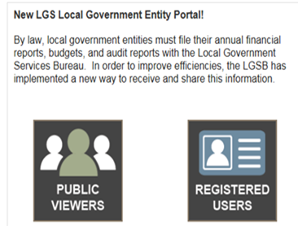
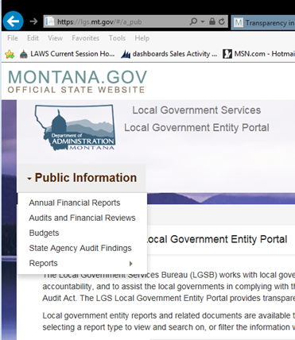
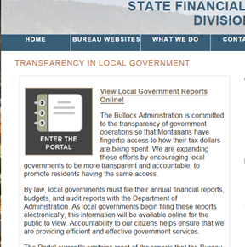
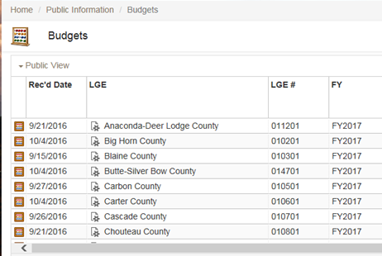
Transparency in Local Government Website:
Step 1: From LGSB website – Click on Public Viewer
Step 3: Click on Document Type to be viewed
Step 2: Click on Enter the Portal
Step 4: Scroll through reports

Slide 67




Local Government Services Bureau
Assistance and Questions:
Montana Association of Counties
406-444-9101
http://sfsd.mt.gov
406-449-4360
www.mtcounties.org
Montana League of Cities and Towns
MSU Local Government Center
406-442-8768
www.mtleague.org
406-994-6694
www.msulocalgov.org

