Slide 1
Pretrial Diversion
Robin E. Wosje Senior Program Manager
The Justice Management Institute

Slide 2
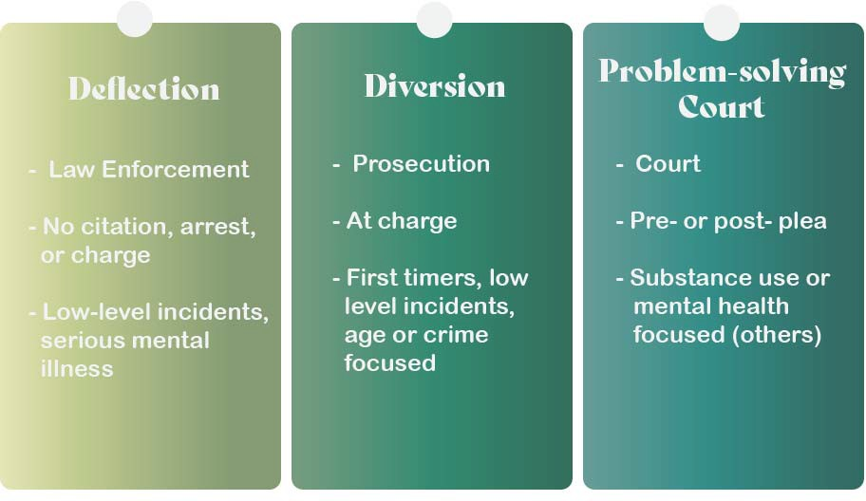
Pretrial Diversion

Slide 3
Deflection Models
Law Enforcement Assisted Diversion (LEAD: King County, WA)
Co‐Responder Model (Johnson County, KS)
Yellow Line Project (Blue Earth County, MN)
Crisis Intervention Teams
Triage Centers

Slide 4
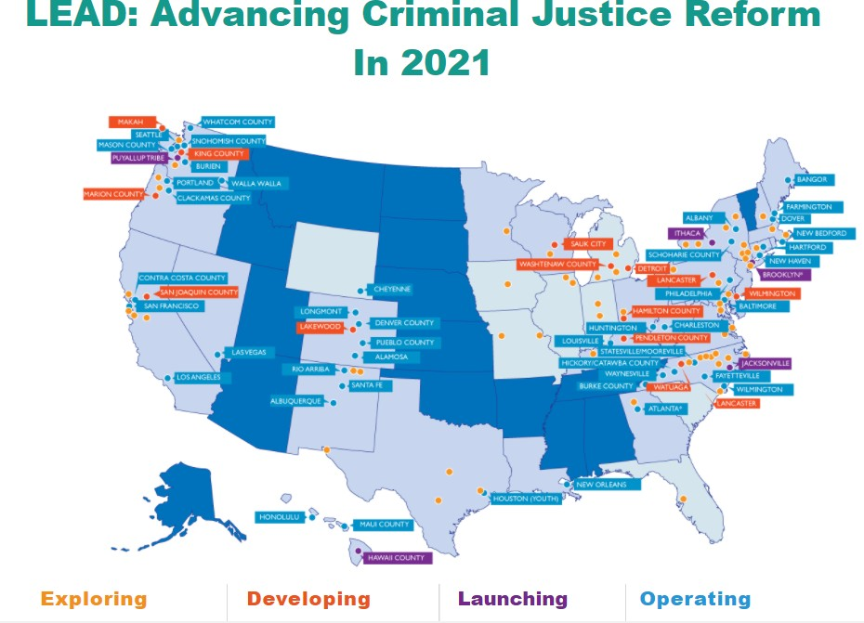
Downloaded from: https://www.leadbureau.org/

Slide 5
Prosecutor‐Led Diversion
Post‐filing
Charge‐based and charge‐restricted
Program Goals:
hold participants accountable;
reduce participant recidivism;
rehabilitate participants by treating underlying problems; and
use resources more efficiently
Do no harm

Slide 6
Prosecutor‐Led Diversion
Target Population
Screening and Assessment
Program Requirements:
community service
substance abuse education
substance abuse treatment
individual therapy (42%)
Supervision (44%)

Slide 7
Prosecutor‐Led Diversion
Prosecutor only programs
Limited checks or balances
Potential for net‐widening
Transparency
Program comparisons
Equity in participants
Limited studies and evaluations

Slide 8
Yellow Lone Project https://www.yellowlineproject.com/ Blue Earth County, MN (Mankato) (Pop: 67,653) https://youtu.be/6ycaGNZQgNI

Slide 9
Yellow Line Project
https://www.yellowlineproject.com/
Blue Earth County, MN (Mankato) (Pop: 67,653) https://youtu.be/6ycaGNZQgNI

Slide 10
Resources
Prosecutor‐Led Diversion: A National Survey, Center of Court Innovation, March 2019 : Survey of some of the main prosecutor‐led programs that exist in the United States. https://www.courtinnovation.org/sites/default/files/media/document/2019/prosecutor‐ led_diversion.pdf
Prosecutor‐Led Pretrial Diversion: Case Studies in Eleven Jurisdictions, Center for Court Innovation, April 2018 : Evaluation of 16 diversion programs in 11 different offices: https://www.courtinnovation.org/sites/default/files/media/documents/2017‐ 11/pretrial_diversion_case_study_report_final_provrel.pdf
Models of Prosecutor‐Led Diversion Programs in the United States and Beyond, Annual Review of Criminology, 2021 : Discussion of some of the pitfalls of prosecutor‐led diversion including net widening, unilateral decision making and limited accountability, challenges of documenting results, and program and eligibility criteria. https://www.annualreviews.org/doi/abs/10.1146/annurev‐criminol‐061020‐022236

Slide 11
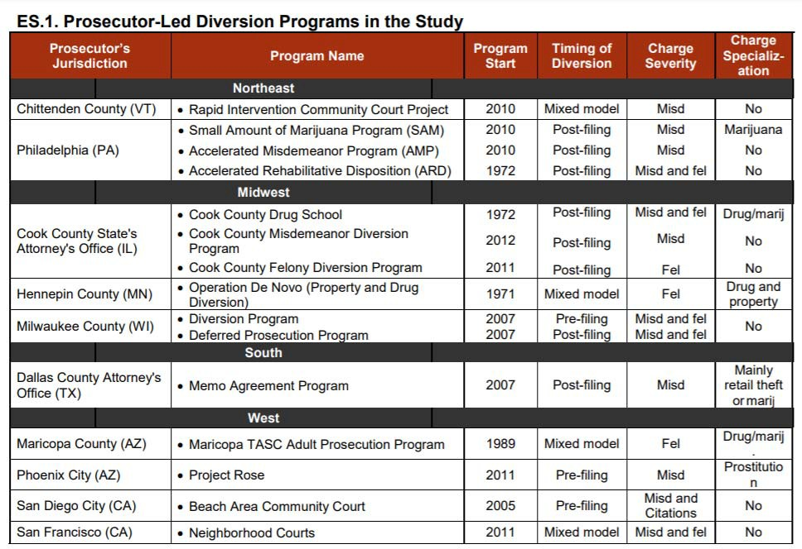

Slide 12
Thank you!
Robin E. Wosje

