Slide 1
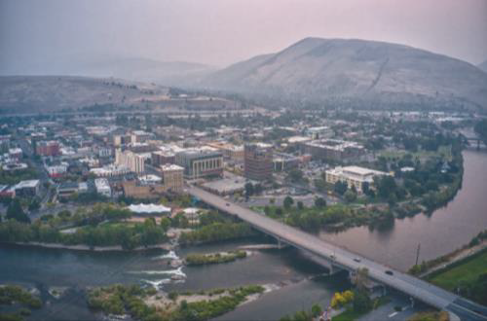
Montana Recovery Residences

Slide 3
90,000
Approximately 90,000 Montanans have a substance use disorder

Slide 4
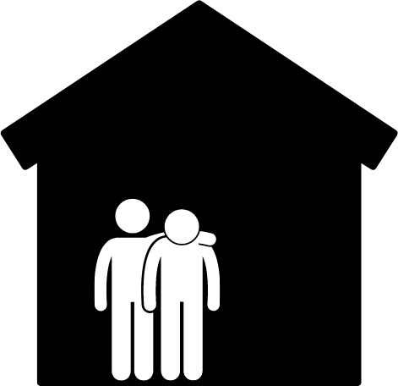
BENEFITS TO RESIDENTS
Furnish social capital and recovery supports
Provide a substance-free environment
Mutual support from fellow recovering residents
Informal sharing of resources and advice among residents

Slide 5
RECOVERY RESIDENCES
Follow nationally recognized best
practices
Support long-term recovery with structures that keep people out of systems, reducing encounters with law enforcement and Department of Corrections
Certified

Slide 6
MONTANA RECOVERY RESIDENCE
ADVISORY COMMITTEE

Slide 7
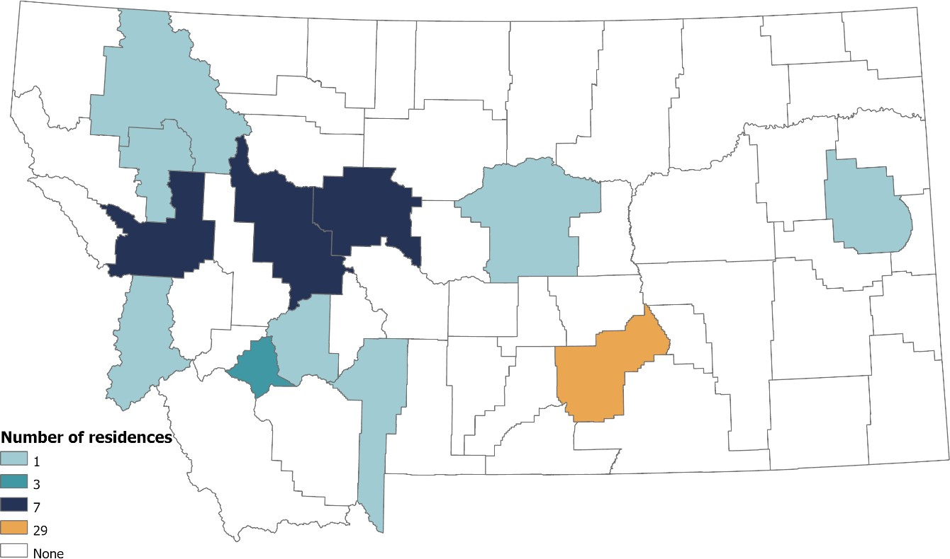
MONTANA RECOVERY RESIDENCES BY COUNTY
60 unlicensed recovery homes surveyed

Slide 8
MONTANA RECOVERY RESIDENCE POPULATIONS SERVED
100%
85%
80%
75%
60%
50%
55%
40%
40%
30%
20%
15%
0%
Men
Women
Pregnant
Any Substances
Veterans
Some criminal
justice-involved
Registered
Offenders

Slide 9
JUSTICE-INVOLVED INDIVIDUALS IN MONTANA
Substance use and mental health treatment needs
Need Housing
DOC Rental support

Slide 10
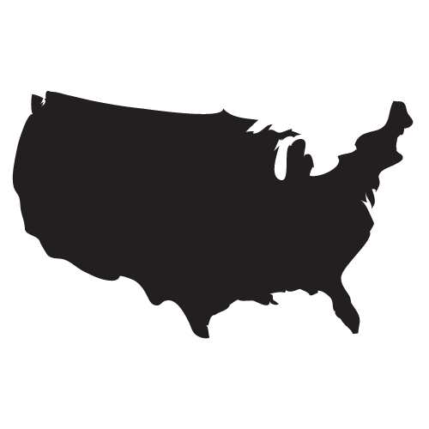
501(c)3
National Standards
Certification
MONTANA NARR AFFILIATE

Slide 11
STATE OF MONTANA
Sustainable model
Supports long-term recovery
NARR certification
Funding opportunities for certified homes
Support for new and existing homes
Registry for referrals

Slide 12
Questions? Contact:
Ki-Ai McBride
Opioid Prevention Program Manager
Addictive & Mental Disorders Division
Montana Department of Public Health and Human Services
ki-ai.mcbride@mt.gov

