Slide 1
OFFENDER HOUSING
Montana Department of Corrections
Presentation to Montana Criminal Justice Oversight Council
Wednesday, Oct. 27, 2021

Slide 2
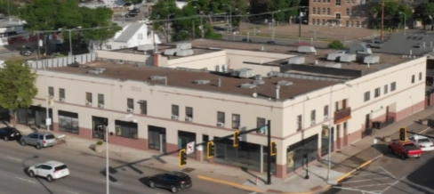
Montana Prerelease Centers & Offender Reentry

Slide 3
What is a Prerelease Center?
Generally six-month programs designed to help offenders transition from a secure facility back into the community, as well as provide an alternative to incarceration.
Offenders work in the community but live at the center.
Travel in the community is according to a pre-approved schedule and is subject to security checks.
Each offender has an individualized case plan comprised of treatment and programming identified through court orders, risk and needs assessments, offender goals, etc. Treatment and programming can be offered in-facility or in the community.

Slide 4
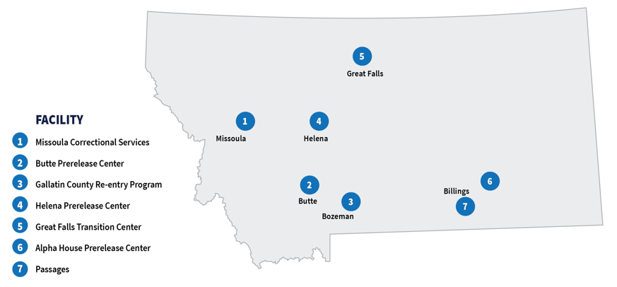
D
Montana Prerelease Centers
Notes:
.

Slide 5
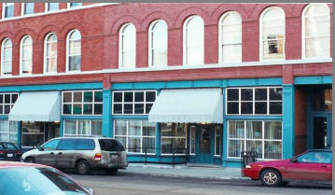
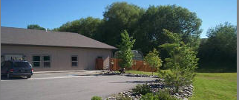
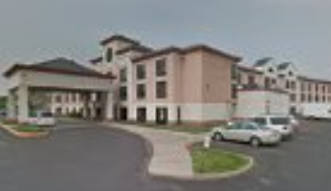
Some Considerations
Centers are located in population centers.
Each facility has a local screening committee that determines acceptance or denial.
Not all facilities take all offender types (e.g. sex offenders, arsonists).
Offenders with special needs who don’t fit the traditional mold for prerelease center residents can be difficult to place.

Slide 6
Sentencing Commission and Senate Bill 65

Slide 7
History
SB 65 was introduced in the 2017 Montana Legislature as part of the Justice Reinvestment suite of bills.
A significant factor in offenders not being paroled is their inability to secure appropriate housing in the community.
The legislation was intended to improve access to housing for offenders returning to communities after incarceration by allowing the DOC to provide housing assistance. (This did not receive funding in the 2017 session.) In addition, the bill created a supportive grant program to be administered by the Montana Board of Crime Control.
The 2019 Montana Legislature funded the rental voucher program by providing $200,000 annually for this purpose.
The DOC adopted ARM 20.13.108 to clearly define offender eligibility and allowable expenses.
In 2021, the Montana Legislature provided that wrongful conviction claimants are entitled to a housing voucher pursuant to 46-23-1041 while the action is pending.

Slide 8
Used to assist parolees with rent for a maximum of three months, based on financial eligibility requirements contained in ARM.
Eligible Offenders: Those re-entering the community directly from prison, or from a residential treatment program to which the offender was conditionally paroled from prison, are eligible for rental vouchers.
What are rental vouchers?
Notes:
The department considers the funds paid out to assist offenders with their rent a wise investment that facilitates offender success in the community and avoids the costs associated with parole revocations.

Slide 9
Requests are made by DOC staff to the Programs & Facilities Bureau and are reviewed according to procedure and ARM.
The department has no contractual relationship with landlords under the rental voucher program.
Payments are distributed directly to landlords by the department, on behalf of an offender, after the residence has been determined appropriate. Payments are not made directly to offenders.
What are rental vouchers?
Notes:
The department considers the funds paid out to assist offenders with their rent a wise investment that facilitates offender success in the community and avoids the costs associated with parole revocations.

Slide 10
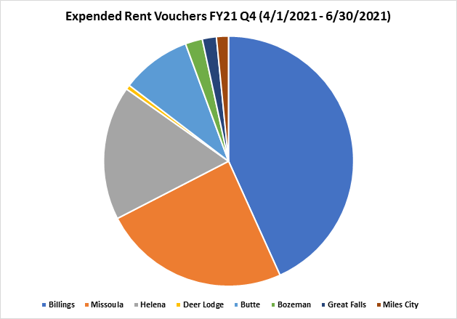
Rental Voucher Usage
Billings: $16,625 (6 vendors)
Missoula: $9,295 (7 vendors)
Helena: $6,675 (5 vendors)
Deer Lodge: $225 (1 vendor)
Butte: $3,470 (3 vendors)
Bozeman: $850 (1 vendor)
Great Falls: $700 (1 vendor)
Miles City: $600 (1 vendor)
Total: $38,440
(COVID19-related = $23,665)

Slide 11
Requests are made by DOC staff to the Programs & Facilities Bureau and are reviewed according to procedure.
May be used for justifiable expenses supportive of offender success in the community. (e.g. rent, rent deposits, transportation, emergency housing, treatment/programming costs, etc.)
Payments are distributed directly to landlords by the department, on behalf of an offender, after the residence has been determined appropriate. Payments are not made directly to offenders.
What are transitional assistance funds?
Notes:
The department considers the funds paid out to assist offenders with their rent a wise investment that facilitates offender success in the community and avoids the costs associated with parole revocations.

Slide 12
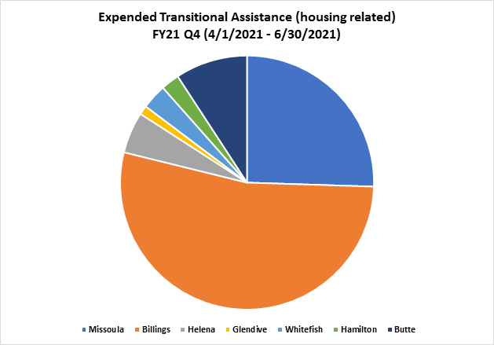
Transitional Assistance Usage
(Housing-related expenses only)
Missoula: $3,601.59 (5 vendors)
Billings: $7,532 (7 vendors)
Helena: $743.66 (2 vendors)
Glendive: $162 (1 vendor)
Whitefish: $450 (1 vendor)
Hamilton: $331 (1 vendor)
Butte: $1,300 (1 vendor)
Total: $14,120.25

Slide 13
Probation and Parole: Helping Ensure Offender Success in the Community
To help ensure offender success in the community, Probation and Parole officers must review offender release plans. In so doing, they consider the following:
Appropriateness of residence
Adequacy of employment
Risks, needs and community resources
Special conditions that would enhance the prospects of success
Victim input

Slide 14
Factors to Consider: Appropriateness of Residence
Are there firearms in the home?
Is there alcohol or drugs in the home?
Does the offender have their own room in which to sleep?
Are there other people on supervision who live in the residence? If a single-family home, is the other person on supervision in the home in compliance with supervision?
Is there dog at the residence? If yes, is the dog aggressive?
Do family/friends cohabitating in the residence agree to remove firearms/alcohol from residence?
If residence is group living situation (such as sober living home), is the person who operates the home amenable to communication with probation and parole? Will they respond to concerns from probation and parole? Are there currently any concerns/issues going on at the home?
Regarding sex offenders- are there children under the age of 18 in the home?

Slide 15
Challenges Related to Sober Living Homes
Current challenges include:
No regulatory structure exists for these types of residences except local zoning and habitability.
Questions on applicability of the landlord/tenant act to these residences.
No contractual relationship; DOC has no authority to require return of funds when appropriate.
Inconsistent application processes and resident expectations.

Slide 16
QUESTIONS?

